Slide 1


Household Energy Consumption Analysis

Slide 2
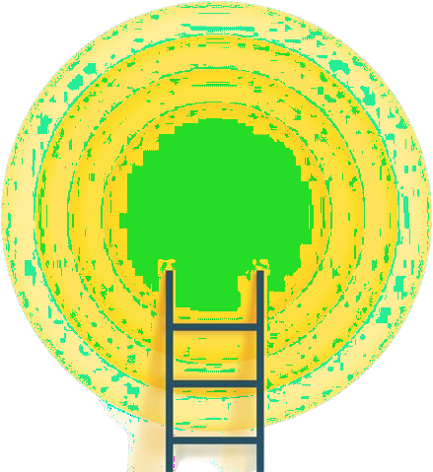
Learning Objectives
Analyze Consumption Patterns
Gain deep insights into household energy usage trends across time and appliance categories.
Perform Data Preprocessing and Feature Engineering
Clean and transform the dataset to enhance quality and extract meaningful features.
Build and Train Predictive Models
Develop optimized machine learning models to accurately predict energy consumption.
Evaluate Model Performance
Use metrics like R², MAE, and RMSE to validate model efficiency and
prediction accuracy.
Create Insightful Visualizations
Present key findings visually to highlight consumption patterns and model performance.
Develop Real-World Application Insights
Translate analytical findings into actionable recommendations for energy-saving strategies and smart-home optimization.
GOAL

Slide 3
Tools and Technology used
Python – Programming language for data processing and model building.
Jupyter Notebook / Google Colab – Interactive environment for coding and visualization.
Pandas & NumPy – Data manipulation and numerical computation libraries.
Matplotlib & Seaborn – Visualization tools for plotting energy trends and model metrics.
Scikit-learn – Machine learning library used for model training, evaluation, and prediction.
Version Control: Git and GitHub (GitHub repo: Sriswathi2007/Energy) for managing project code and collaboration.

Slide 4
Methodology
Data Collection
Acquired household energy consumption data from reliable sources (CSV dataset).
Data Preprocessing
Cleaned missing values and formatted timestamp features for analysis.
Feature Engineering
Extracted useful features like hour, day of week, and previous energy usage.
Model Building
Trained machine learning models (e.g., Random Forest, Linear Regression) to predict energy consumption.
Model Evaluation & Visualization
Assessed performance using R², RMSE, and visualized results for insights.

Slide 5
Problem Statement:
Rising Energy Usage: Households are consuming more energy due to increasing electrical appliances.
Lack of Consumption Awareness: Users don’t have clear insights into how and when energy is being used.
Need for Prediction: Predicting future energy usage can help reduce wastage and lower electricity bills.

Slide 6
Solution:
Predictive ML Model:
A supervised learning model predicts household energy usage (e.g., energy in kWh) based on input factors such as time of day, appliance usage, temperature, and occupancy.
Actionable Insights:
The system identifies key drivers of energy consumption (e.g., specific appliances, temperature variations), helping users and energy providers make smarter decisions to reduce wastage and improve efficiency.
User-Friendly Interface:
Insights and predictions can be integrated into an interactive dashboard or app, allowing non-technical users to input data and visualize energy patterns over time.

Slide 7
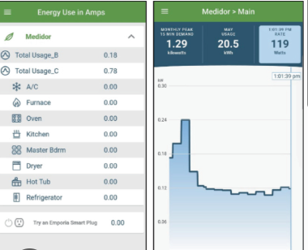
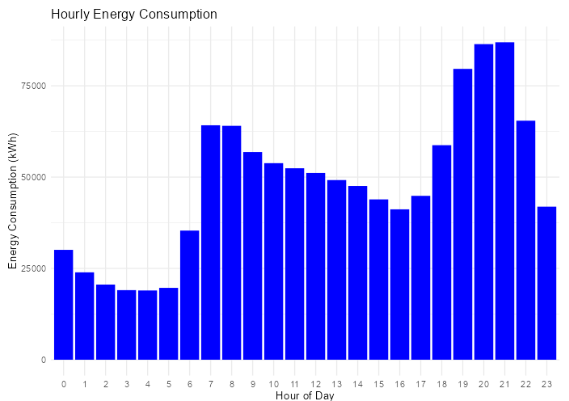
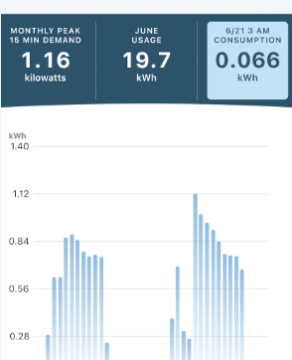
Screenshot of Output:

Slide 8
Conclusion:
Accurate Predictions: Machine learning models effectively forecast household energy consumption.
Actionable Insights: Key consumption patterns and factors are identified to support energy-saving strategies.
Future Scope: The model can be integrated into smart systems for real-time usage monitoring and optimization.

